Slide 1
ARP Forecast Lunch and Learn
2017-18

Slide 2
Agenda
Forecast Overview
Data Movement between ARP and Banner
Forecast Timing
Forecast Reports
Forecast Training
Tips & Tricks: Expert User Demo (Tracy Biggs)
Q&A

Slide 3
Forecast Overview
What is a Forecast?
A projection of year-end results, made up of:
Actuals (to date - through prior closed month)
Projection for remaining months based on your Adjusted Budget (as of August 28th)
Replaces YTD Reporting
Same Templates (WFP, OpEx, Pooled Labor, Transfers)
Same Process (for Template changes)
Reminder: short-videos available
Adopted (July 1)
Adjusted (Aug 28)
Forecast

Slide 4
Forecast Overview
A view of the Forecast in the OpEx template as of Oct 2017 (Fiscal Year 2018):
FY18_Forecast scenario
Totals are not expanded when opening the template to allow for a cleaner look.
Click on the underlined text to expand and collapse the monthly detail.
Actuals are highlighted in orange and are fed from Banner at month-end close
The projection is highlighted in yellow and is seeded from the Adjusted Budget as of August 28th. These remaining months are where units can make changes.

Slide 5
Forecast Changes
What kind of changes can I make in the Forecast?
WFP*
Vacants
Start date (defaults to July 1, 2018)
End Date
Salary $
Name
Filled Jobs
End date
Non-WFP
Pooled Labor**
Non-Labor
Revenue
Transfers
**Recommendation for Contingency Dollars:
Change ‘start’ and ‘end’ periods to 1
*Please note that any WFP changes made in Forecast also need to be made in Banner

Slide 6
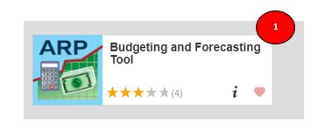
How Will Data Move?
Forecast exists in Host only
WFP Data Will Be Refreshed from Banner HR – 2x per month
At the end of each month, the forecast is “rolled” and the previous month’s forecast is replaced with Actuals from Banner
Actuals for prior month will be updated daily from the 1st through the month-end close, as defined by the Controller’s Office
Refresh dates will be posted on the Budget Office website at budget.nd.edu
(under the section titled ARP) and as an announcement on the ARP icon on InsideND

Slide 7
Forecast Timing
JULY
Quarterly Forecasting REQUIRED
Quarterly Forecasting OPTIONAL
JUNE
AUG
MAY
SEPT
1st Quarter
APR
OCT
3rd Quarter
MAR
NOV
2nd Quarter
FEB
DEC
JAN

Slide 8
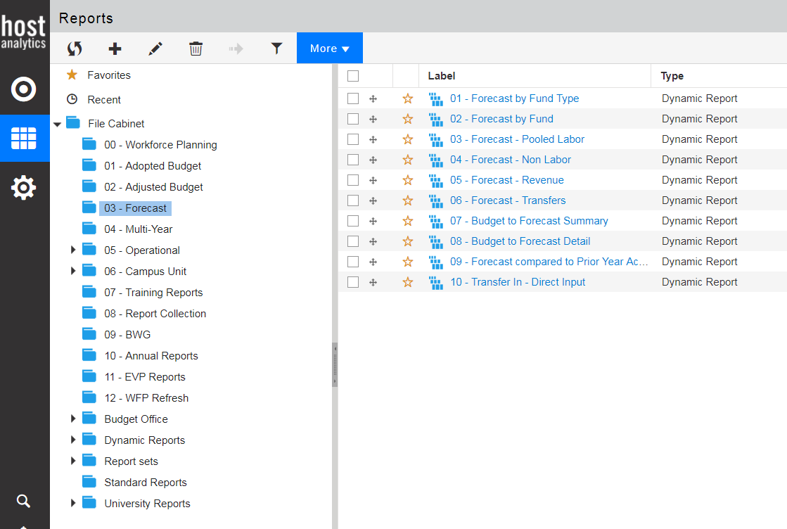
Forecast Reports
Reports required to be submitted at Q2 and Q3

Slide 9
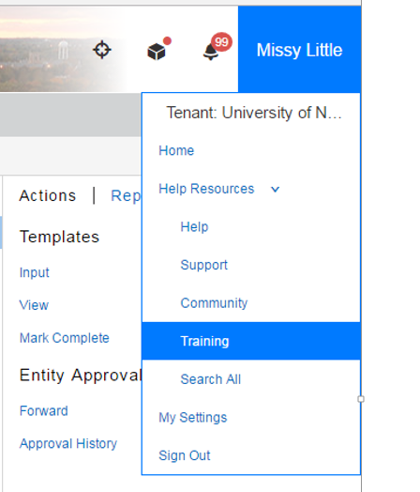
Training Support
Roadmap (handout)
Report Guide (handout)
Short Videos (EPM Academy*)
ARP Short Video Series (How-To)
Coming in Nov: Tips & Tricks
Coming Next: Individual and Small Group training sessions
*Please contact the Budget Office if you need a new login or password

Slide 10
Tips & Tricks: Expert User Demo
Frequently Used Reports
05 - Operational > All Funds
Report 03 - Fiscal 18 All Funds Bud vs Act - Monthly Detail
03 - Forecast
Report 02 – Forecast by Fund
Report 08 – Budget to Forecast Detail
Viewing Transaction Level Detail
Within a report click on “Format” and select “Transactions” under Drill Through and then select “Apply”
Questions

